Slide 1
Textbook circle: Black Hole Astrophyscs
Meeting date : 9/30
Student: Yu-Xing Cheng
Professor: Yousuke Miznuo

Slide 2
Ch6
Geometry and Physics without Gravity: Special Relativity

Slide 3
Ch6.1 Why Geometry?
Since Albert Einstein published his theories of special and general relativity,in 1905 and 1915,it has been recognized that geometry is important not only to mathematics,but also to physics as well.
Two Major reason for this.

Slide 4
Ch6.1 Why Geometry?
First, it has become very apparent that the fundamental number of dimensions that describe our(macroscopic) world is four , not three.
Second, Geometry is important to physics is the discovery that gravity is the result of matter bending the geometry of space and time , so that it is no longer the “flat” geometry of special relativity.

Slide 6
Ch6.2 Two-dimensional pythagorean geometry
Line Element:
The most fundamental equation of plane geometry is the Pythagorean theorem for a right triangle $h^{2}=x^{2}+y^{2}$
x and y are two sides of the triangle and h is the hypotenuse.
The distance $∆h$ between two points on a graph
$${(∆h)}^{2}={(∆x)}^{2}+{(∆y)}^{2}={(x_{2}−x_{1})}^{2}+{(y_{2}−y_{1})}^{2}$$
The very small coordinate distance
$${dh}^{2}={dx}^{2}+{dy}^{2}$$
This equation is called line element

Slide 7
Ch6.2.2 line element has the same length in any coordinates
Example
A translation of the origin to a new location $\left(x_{0},y_{0}\right)$ produces the coordinate transformation$x^{′}=x−x_{0}$,$y^{′}=y−y_{0}$,the $dh$ still given by
$${({dh}^{′})}^{2}={({dx}^{′})}^{2}+{({dy}^{′})}^{2}={(dx)}^{2}+{(dy)}^{2}={(dh)}^{2}$$
$dx_{0} and {dy}_{0}$ are be zero

Slide 8
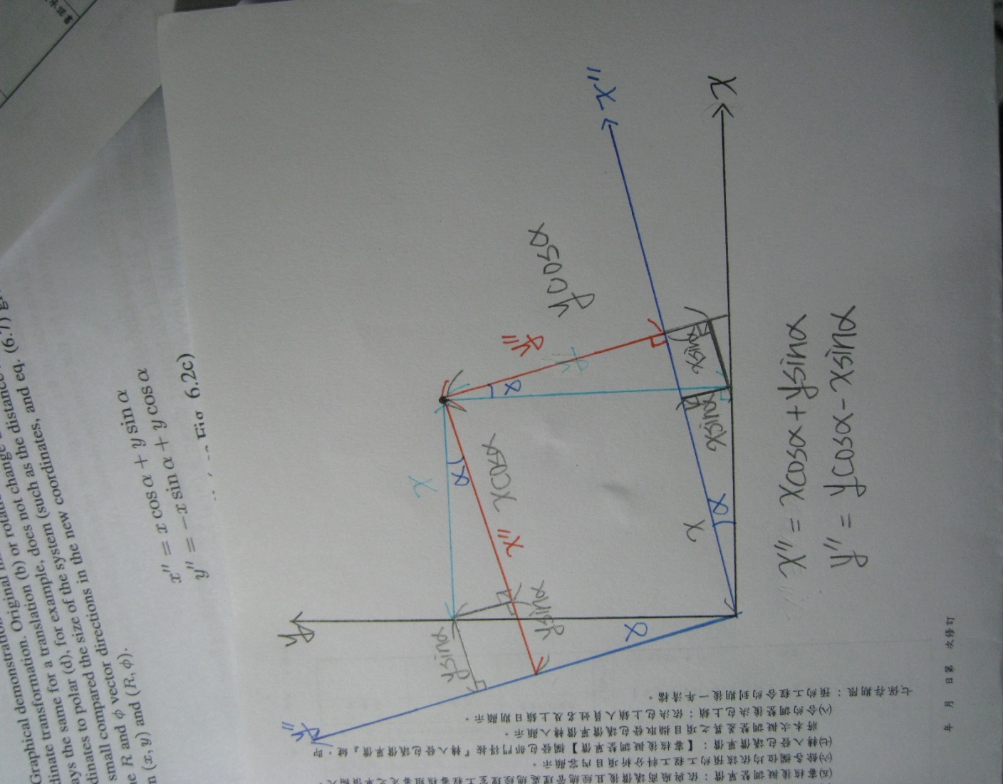
Ch6.2.2 line element has the same length in any coordinates
A rotation of the axes by a constant angle $α$

Slide 9
Ch6.2.2 line element has the same length in any coordinates
From Cartesian(x,y) to Polar (R,$∅$)
$x=Rcos∅ y=Rsin∅$
Combine equation to ${(dh)}^{2}={(dx)}^{2}+{(dy)}^{2}$
Get follow
Therefore, Geometry remains unchanged during any coordinate transformation.

Slide 10
Matrm form for the geometry equations
The Metric
It will help our to illustrate the concept of matrics,vectors,1-form,and tensors.
Equation ${(dh)}^{2}={(dx)}^{2}+{(dy)}^{2}$ can be written ${(dh)}^{2}={dx}^{T}gdx$
Where $dx=(\begin{matrix}dx \\ dy\end{matrix})$ , ${dx}^{T}=(\begin{matrix}dx & dy\end{matrix}$),
$g=(\begin{matrix}1 & 0 \\ 0 & 1\end{matrix})$ is metric of a flat two-dimensional plane in Cartesian coordinates.

Slide 11
Matrm form for the geometry equations
Similarly equation ${dh}^{2}={dR}^{2}+R^{2}{d∅}^{2}$ can be written in matrix form as ${dh}^{2}={{dx}^{′′′}}^{T}g^{′′′}{dx}^{′′′}$
Where ${dx}^{′′′}=(\begin{matrix}dR \\ d∅\end{matrix})$ , $g^{′′′}$=($\begin{matrix}1 & 0 \\ 0 & R^{2}\end{matrix}$)
$g^{′′′}$ is the matric of a flat plane but expressed in polar coordinate.

Slide 12
Coordinate Transformations: Vectors and 1-Form
For the conversion from Cartesian to polar coordinates, we have
${dx}^{′′′}=L∙dx$
The coordinate transformation matrix L is
L=$\frac{1}{R}$($\begin{matrix}Rcos∅ & Rsin∅ \\ −sin∅ & cos∅\end{matrix}$)
The invrse coordinate transformation also can be expressed in matrix form
$$dx=L^{−1}{dx}^{′′′}$$
Where
$L^{−1}=(\begin{matrix}cos∅ & −Rsin∅ \\ −sin∅ & cos∅\end{matrix})$ , $L^{−1}∙L=I$
L is a differential transformation that operates on local vectors and 1-forms

Slide 13
Coordinate Transformations: Vectors and 1-Form
In equation ${dx}^{′′′}=L∙dx$ , $dx$ is called a contravariant vector or vector
In the transformation equation for the components of any vector V, the matrix of the vector’s $V^{′′′}$
$$V^{′′′}=L∙V$$
$V^{′′′}$: the new coordinate system V: the old system
$$V=\left(\begin{matrix}V^{x} \\ V^{y}\end{matrix}\right)$$
Where V is contravariant vector (superscripts)
Notes:
V is contravariant vector

Slide 14
Coordinate Transformations: Vectors and 1-Form
The contravariant vector whoes components transform in the opposite manner to those of a contravariant vector
$ν^{′′′}=υ∙L^{−1}$ , $ν^{′′′}$ is new coordinate system
$υ$ and V are different geometric quantities that transform in different ways.

Slide 15
Dot products and magnitudes of vectors
How to compute the magnitude of all vectors V?
$V^{2}=V^{T}∙g∙V$ and $v≡V^{T}∙g$
Transforms according to equation $ν^{′′′}=υ∙L^{−1}$
Rewrite $V^{2}=v∙V$
Use ${(AB)}^{T}=B^{T}A^{T}$ to $v=V^{T}∙g$ , get $V=g^{−1}∙v^{T}$
$V^{2}=v∙g^{−1}$ $v^{T}$

Slide 16
Tensors
Discussion of two-dimensional geometry by looking at how the metric itself transforms.
Combine equation ${dh}^{2}={dx}^{T}gdx , {dh}^{2}={{dx}^{′′}}^{2}g{dx}^{′′}$ , ${dx}^{′′}=L∙dx$ to solve for $g^{′′′}$ in term of g to get $g^{′′′}={(L^{−1})}^{T}∙g∙L^{−1}$
g is called covariant tensor of rank 2
$g=(\begin{matrix}g_{11} & g_{12} \\ g_{21} & g_{22}\end{matrix})$ , it has a special property that is always symmetric $g^{T}=g$
g is not called a 2-form , because true 2-forms must possess another property- antisymmetry

Slide 17
Tensors
Matrix can be converted to a contravariant form by taking its inverse
${(g^{′′′})}^{−1}={({(L^{−1})}^{T}∙g∙L^{−1})}^{−1}$, use ${(ABC)}^{−1}=C^{−1}B^{−1}A^{−1}$
Get ${(g^{′′′})}^{−1}=L{∙g}^{−1}∙L^{T}$
In general we can get covariant tensor t into contrvariant T vector
form is $T=g^{−1}∙t∙g^{−1}$
$g^{−1}$ is also the corresponding 2-tensor for g by
G= $g^{−1}∙g∙$ $g^{−1}$= $g^{−1}=(\begin{matrix}g^{11} & g^{12} \\ g^{21} & g^{22}\end{matrix})$

Slide 18
A word of warning: global vs local transformations
Global coordinate transformation is one can express the new coordinates as complete and independent functions of the old coordinates.
Example
$$x^{′}=f\left(x,y\right) y^{′}=g(x,y)$$
f and g being independent function of the old coordinates.
A global transform can be written in a differential or matrix manner
${dx}^{′}=a\left(x,y\right)dx+b\left(x,y\right)dy ,$ ${dy}^{′}=c\left(x,y\right)dx+d(x,y)$dy
These expressions must be total differentials, expressible in the form
${dx}^{′}=d[f(x,y)]$ ,${dy}^{′}=d[g(x,y)]$
Global transformations allow the points in an entire space to be re-label from, say (x,y,z,….) to ($x^{′},y^{′},z^{′}….$) : they work everywhere in space
Notes:
12/9 news

Slide 19
A word of warning: global vs local transformations
Local transformation is one that may be expressed in differential or matrix form, but cannot be integrated into the global form.
A simple example would be following transformation from polar coordinates (R,$∅$) local to a local orthonormal system ($x^{′}$,$y^{′}$) at a single point ${dx}^{′}=dR$ , ${dy}^{′}=Rd∅$

Slide 20
Three-dimensional euclidean geometry
According to previous inference , we can get more general result at following:
In this plane the Pythagorean theorem(Fig6.4)
${∆l}^{2}={∆h}^{2}+{∆z}^{2}$ combine this with ${∆h}^{2}={∆x}^{2}+{∆y}^{2}$
We get ${∆l}^{2}$=${∆x}^{2}+{∆y}^{2}+{∆z}^{2}$

Slide 21
Three-dimensional euclidean geometry
cylindrical coordinate system:
$${dl}^{2}={dR}^{2}+R^{2}{d∅}^{2}+{dz}^{2}$$
spherical-polar coordinate system:
${dl}^{2}$=${dr}^{2}+r^{2}{dθ}^{2}+r^{2}\sin^{2}θ{dφ}^{2}$
The magnitude:
$V^{2}=V^{T}∙g∙V$= $v∙g^{−1}$ $v^{T}$
$$g=(\begin{matrix}1 & 0 & 0 \\ 0 & 1 & 0 \\ 0 & 0 & 1\end{matrix})$$

Slide 22
Thank you for listening

